Slide 1

How to study the Bible
The Word of God
History of the Bible
Tools for understanding the Bible
Part 1
Notes:
Today we're focusing on how to study the bible but more importantly, how to increase your knowledge of the bible. In this series we're going to look at “The Word of God”, which includes the Hebrew and Greek manuscripts, the bibles we use today and the tools we need to accurately study.
God gave me the desire to study his word, in depth, about 25 years ago. Since then, I’ve put together several of these studies on different topics recently however, God has called me to start teaching what I’ve learned, and I believe this is what he’s prepared me for all those years ago. I’m here to share with you the process I use, and I pray you will start using the same process in your studies. You will be amazed at how much of God’s word you didn’t understand. When God called me to this, I couldn’t believe how much I didn’t know. When I learned how to study the Bible instead of just reading the Bible, my knowledge grew fast, it was so exiting to start learning, all of God's Word. If you are serious about it and willing to do some research, you’ll experience the same joy and excitement that I still have today.
When God called me to this, for the first 3 years I couldn’t stop. I was up at 4 am, seven days a week. I would learn something new and chased every rabbit trail I could find, to prove to myself what I was reading was right. I couldn’t stop. That’s how I know this was God. He put me in a state of mind I’ve never experience before. Studying God's word was all I could think about for years and 25 years later, I crave the word and still study several days a week. That same feeling has returned, but now it’s a need to complete my work and share it with the world, if you have a desire for the knowledge of God's word. I'm here for you! Amos 8:11 says there will be a famine not of food or drink but for the Word of God and that famine has been in effect for a couple generations.
You’re probably going to hear some things today you're not familiar with.
So, when you do. Just because something is rarely or never taught, does not mean that it’s not true.
So please don’t judge until you’ve done your homework (using the tools you’re about to learn about today). There are many parts of the bible that are difficult to understand. There are parts that are not meant to be understood, that is, until God’s plan requires it. He also has people that he’ll use to bring forth this knowledge and that time has come. The return of Jesus is close at hand and time is running out. If you want to understand the prophecies and what’s coming in these end times, we’ll cover it all.
In closing my introduction: I want to say many churches have great preachers, who are called to preach the gospel. But most are not called to spend years searching the Old Testament for the prophecies. My point here is the church needs both, my passion and desire for complete understanding and that same passion and desire for saving souls. I do not have that same passion for evangelism, but the church needs both and both "are expectations of God".

Slide 2
History of the Bible
Pray for understanding, wisdom, and the desire to work hard to reach that understanding. God will bring the knowledge.
"The Word of God". They're a lot of books out there that have the word bible on the cover and in the title. Some are good translations, and some are bad.
The ancient Manuscripts, these were originally written by God's prophets who were inspired by God and were then copied and past down from Generation to Generation over hundreds and in some cases thousands of years. Some of these texts have names: The Codex Sinaiticus, Codex Alexandrines both kept in the London, British Library . Just a couple of the most important ones. These books date to the 4th century A.D. (Year 301 to 400 AD).
What BC and AD stand for.
Notes:
The History of the Bible. The first thing we need when studying the bible is God!! We need to pray for understanding, wisdom and the desire to put the work in for that understanding. This isn't an easy process. But if we put the work in, God will bring the understanding. 25 years ago, when I learned how to study the bible I realized how much, I’d never been taught and some things that I learned were completely wrong.
Today we're going to talk about where the Bible came from and the accuracy of the different translations. We put a lot of faith into the words of our Bible, so it's very important to know how it came to be and why it's trusted as "The Word of God". There are a lot of books out there that have the word bible on the cover and in the title. Some are good translations, and some are not. You just can’t' walk into a store, buy any bible, and have God's Word. You need to know who's doing the translating and how.
So, let’s look at the ancient Manuscripts. These were originally written by God's prophets who were inspired by God and then were, copied and passes down from Generation to Generation over hundreds and in some cases thousands of years.
Most, written in Hebrew and Greek; number around 20,000 manuscripts in existence. Some are complete versions of the Old and New Testaments, and some just small pieces with a few words. The important thing is they all say the same thing. These texts were written by many different people, at many different times in history, but the words and stories remain the same. They were copied repeatedly by scribes that specialized in this very important job. And the reason we have some bad translations (in our trusted bibles) today, is because of bad scribes back then. That is why it’s a must to be able to translate the bible back to the original text, because these texts are the inspired scriptures of God and with 20,000 manuscripts that read the same, we can be confident that if there are mistakes in our translations, we will be able to correct it, with an Authorized King James, a Strongs Concordance, and a Greens Interlinear Bible.
There are several controversial subjects that do require it. For me, it was important to see the words and do my own crude translation. I’m going to teach you how to do it for yourself. You are going to learn some things you didn’t know, and some will be contrary to what you’ve been taught. It’s up to you how you handle it. You can cross your arms and say that’s not what so and so said, or you can get out that old King James and Strong’s concordance and see if you can prove what so and so said right or not. I’m going to give you multiple scriptures to look up and clarify many words we normally just read over.
I’m giving you a commonsense approach to studying the bible using God’s word, current world events and world history, that helps prove the Word to be 100% true, and that includes the book of Revelation.

Slide 3
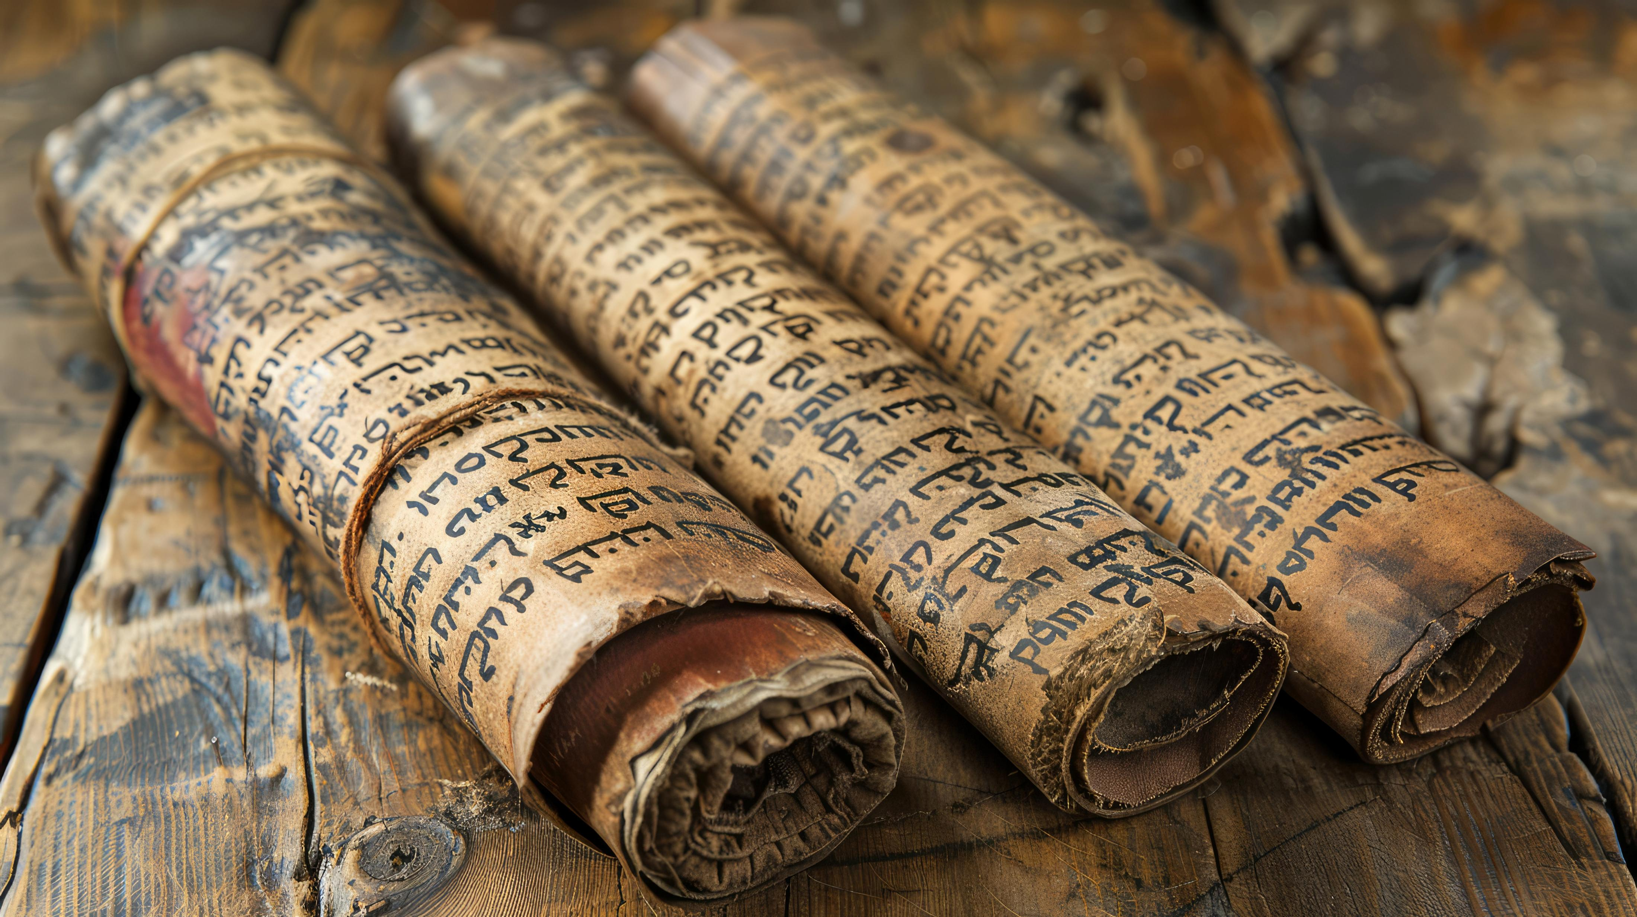
History of the Bible
The bible time-line
Manuscripts
The King James Bible
Other bible translations
Notes:
The bible time-line is; Adam and Eve about 6000 years ago or around 4000 BC. Jesus lived about 2000 years ago. This age or period-of-time we are current living in, will last about 7000 years. The final 1000-year period is the Millenium. Jesus sets up his government and rules the earth for 1000 years, and then we will move into the eternity with God. The Bible calls it, the 3rd Heaven. I'm going to use the word age instead of dispensation just because it fits better and is easy. So, let’s look at what the bible say about ages.
2 Corinthians 12:2-4. Verse 2 says: I knew a man in Christ above (or a clearer translation before) fourteen years ago, (whether in the body, I cannot tell; or whether out of the body, I cannot tell: God knoweth;) such an one caught up to the third heaven. This is Paul talking about when God brought him to heaven to write the book of Revelation, and he doesn't know if he was in spiritual body or his flesh body when this took place.
Ephesians 2:7 That in the ages to come he might shew the exceeding riches of his grace in his kindness toward us through Christ Jesus., This is speaking of future ages. The grace and kindness after sin is removed from the world and the earth is blessed by God again.
Ephesians 3:1 For this cause I Paul, the prisoner of Jesus Christ for you Gentiles,
2 If ye have heard of the dispensation of the grace of God which is given me to you-ward: This the current Earth age we live in today.
3 How that by revelation he made known unto me the mystery; (as I wrote afore in few words,
4 Whereby, when ye read, ye may understand my knowledge in the mystery of Christ)
5 Which in other ages was not made known unto the sons of men, as it is now revealed unto his holy apostles and prophets by the Spirit; Here we're talking about passed ages which is the first earth and heaven age. Before it became void and without form.
Ephesians 3:21 Unto him be glory in the church by Christ Jesus throughout all ages, world without end. Amen.,
Colossians 1:26 (Even the mystery which hath been hid from ages and from generations, but now is made manifest to his saints. This mysteries which were hidden from the ages are about to be revealed to you.
Above are examples of ages as used in the new testament. So, If the Eternity (which is future that Paul was taken to) is the 3rd Heaven Age, then we must be living in the 2nd Heaven age, and I’ll add 2nd Earth Age. This word age in the Greek means "Ions" which means course, eternal, forever. It's where our word Eons comes from, and it's just a period of time usually a very long period of time.
Now the Manuscripts: One of the more recent finding was in 1947 the Dead Sea Scrolls, which date back to the 3rd century B.C. The most complete and of the oldest manuscripts ever found, and this text reads just like the rest.
The King James Bible: The King James Bible was originally written in Elizabethan English, which is a lot different than the English we speak today. There is also a letter from the translators in the front of the Original King James 1611, that acknowledged the potential for errors due to challenges in conveying the exact meaning when translating from Hebrew and Greek, as you will see for yourself.
Other bible translations: The NIV, for example, is a thought for thought translation. That means the translator, reads a passage, and translates the passage how he or she thought it should be translated, which is not an accurate way to translate, you need to be careful of these newer Bibles and make sure you understand how and who translated it. These bibles are easy to read, and a lot of people use them. They are great for ease of reading and at times do help with understanding.and in some places they can be translated better than the King James. But the way to the manuscripts is the King James, and this is where we’ll find God.

Slide 4
History of the King James Bible
Here are some key events in the history of the King James Bible:
1609: The first printing of the King James Bible, which included all 80 books
1611: The King James Bible was revised and printed again, still including all 80 books
1782: Robert Aitken's Bible, the first English-language King James Version to be printed in America, was published
1825: The British and The Foreign Bible Society decided to remove the Apocrypha and reduce the bible to 66 books. These books were never accepted as scripture by the Jews but were held in high esteem. They are worth reading, anything that expands on the word of God. Is worth reading.
1833: Noah Webster published his own revision of the King James Bible
1846: The Illuminated Bible, a lavishly illustrated King James Version, was printed in America
1885: The "Revised Version" Bible was published, marking the first major English revision of the King James Bible
1901: The "American Standard Version" was published, marking the first major American revision of the King James Bible
The King James Bible (KJV) was published in 1611 under the patronage of King James I of England. It was the most accessible and scholarly translation of the Bible at the time, and it influenced English literary style. The KJV was the standard English Bible from the mid-17th century to the early 20th century.
Notes:
Here are some key events in the history of the King James Bible:
1609: The first printing of the King James Bible, which included all 80 books
1611: The King James Bible was revised and printed again, still including all 80 books
1782: Robert Aitken's Bible, the first English-language King James Version to be printed in America, was published
1825: The British and The Foreign Bible Society decided to remove the Apocrypha and reduce the bible to 66 books. These books were never accepted as scripture by the Jews but were held in high esteem. And they are worth reading, anything that expands on the word of God is.
1833: Noah Webster published his own revision of the King James Bible
1846: The Illuminated Bible, a lavishly illustrated King James Version, was printed in America
1885: The "Revised Version" Bible was published, marking the first major English revision of the King James
1901: The "American Standard Version" was published, another revision of the King James
The King James Bible (KJV) was published in 1611 under the patronage of King James the first of England.
The KJV was the standard English Bible from the mid-17th century to the early 20th century.

Slide 5
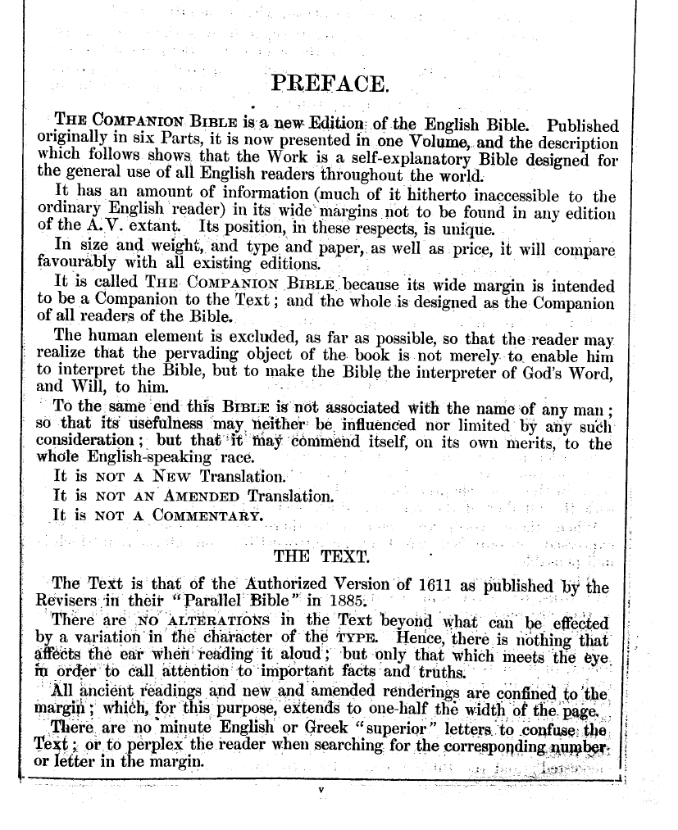
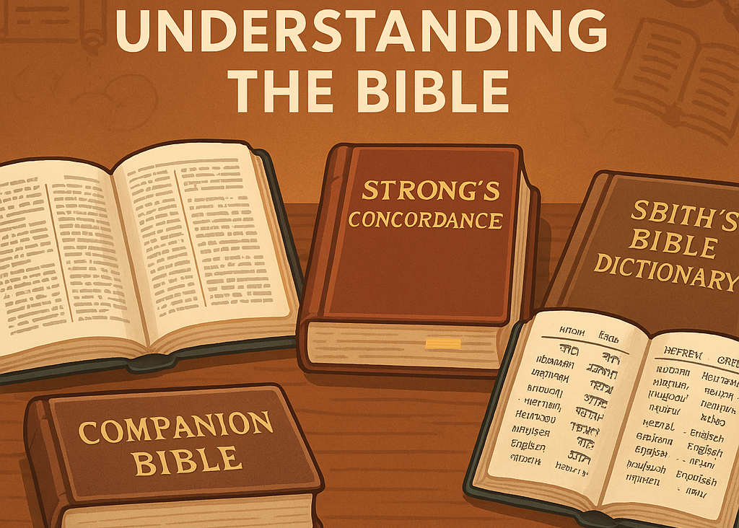
Tools for understanding the Bible
Companion Bible
Strong's Concordance
Smith's Bible Dictionary
Green's Interlinear Bible
The Companion Bible is a King James Study Bible. https://levendwater.org/The%20Companion%20Bible.htm
Notes:
The Companion Bible is a King James Study Bible that helps you understand the original languages. It has side margin with references. At times you may not understand a word, or come across a verse that just doesn’t make sense. There is a good chance that Bullinger has it listed in the side column with notes about other places the word is used in the bible, also notes on history and general notes on translations. https://levendwater.org/The%20Companion%20Bible.htm

Slide 6
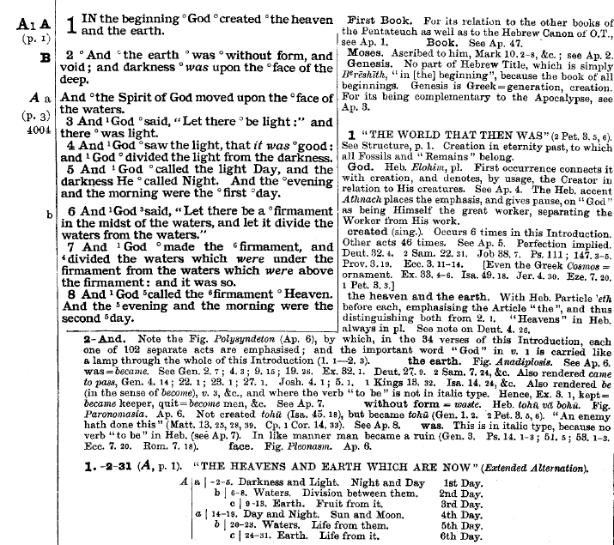
Tools for understanding the Bible
Companion Bible
Strong's Concordance
Smith's Bible Dictionary
Green's Interlinear Bible
The Companion Bible: Examples and how to use.
https://levendwater.org/The%20Companion%20Bible.htm
Notes:
Continuing with The Companion Bible: Let's look at an example of these tools. We start with Genesis chapter 1 verses 1 & 2. Read it. Genesis 1 verse 1. In the beginning God created the heaven and the earth.
2 And the earth was without form, and void; and darkness was upon the face of the deep. And the Spirit of God moved upon the face of the waters.
Sounds straight forward, right! Let's look at the second verse, And the earth was without form and void. In this first verse God just created the Earth. why would he create it void and without form? Doesn’t that seem odd? God just created the earth, and it’s void and without form, he created a mess? Then his spirit moved upon the face of the earth, and here we have the events of Genisis.
Let’s take a closer look and see if we can make better sense of this verse.
https://levendwater.org/The%20Companion%20Bible.htm

Slide 7
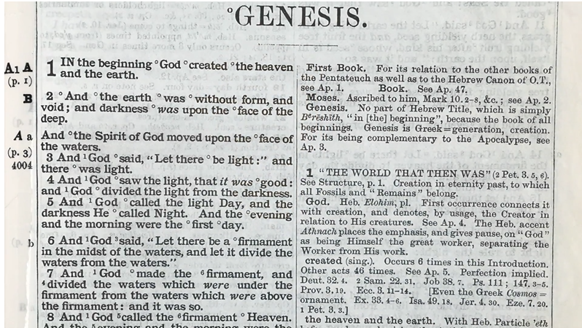
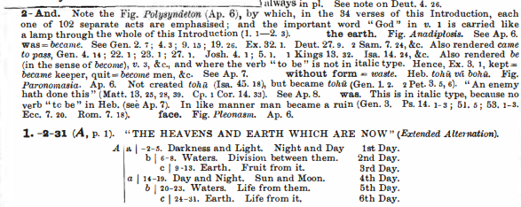


Notes:
God tells us to compare scripture to scripture, so we’re going to look for another place that covers (the Earths creation). The Companion Bible will give you a scripture comparison overload; with this bible you'll never be under informed. (Cover was and without above)
This is a screen shot from the Companion Bible. You see the small circle by the word (was), that means there is a note in the side column. So, let's look in the notes for Verse 2 and we find (was=became). So, this word can be translated either way. In our verse (became) makes a lot more sense than (was) and that will be very clear after we cover Isaiah 45:18. Next word (without form=waste), that’s a good translation, but you’re about to see how your understanding will increase by taking the time see how this word is used in other places. But first let's look at these words in the Strong's Concordance, which is going to give us the same information.

Slide 8
Tools for understanding the Bible
Strong Concordance
The Strongs concordance:
Word Summary (for WAS)
hayah: to fall out, come to pass, become, be
Original Word: הָיָה
Transliteration: hayah
Phonetic Spelling: (haw-yaw)
Part of Speech: Verb
Short Definition: to fall out, come to pass, become, be
Meaning: to fall out, come to pass, become, be
Strong's Concordance become, altogether, accomplished, committed, like, break, cause,A primitive root (compare hava'); to exist, i.e. Be or become, come to pass (always emphatic, and not a mere copula or auxiliary) -- beacon, X altogether, be(-come), accomplished, committed, like), break, cause, come (to pass), do, faint, fall, + follow, happen, X have, last, pertain, quit (one-)self, require, X use.
see HEBREW hava’
Word Summary (for VIOD)
bohu: emptiness
Original Word: בֹּהוּ
Transliteration: bohu
Phonetic Spelling: (bo'-hoo)
Part of Speech: Noun Masculine
Short Definition: emptiness
Meaning: a vacuity, an undistinguishable ruin
Strong's Concordance
emptiness, void From an unused root (meaning to be empty); a vacuity, i.e. (superficially) an undistinguishable ruin -- emptiness, void. Back to previous slide: Bullinger give us a reference for (tohu)
Notes:
So, become or became is making better sense, but we’ve got a ways to go before we can say this is right and that is wrong, we don't without a great deal of proof. The word void: undistinguishable ruin, emptiness and void. Void fits in nicely but let’s take a closer look at void.

Slide 9
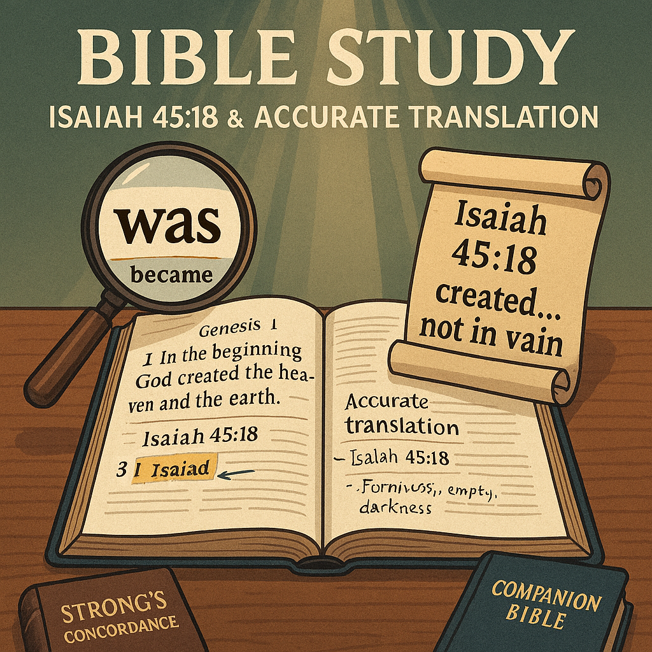
Tools for understanding the Bible
Companion Bible
Strong's Concordance
Smith's Bible Dictionary
Green's Interlinear Bible
Isaiah 45:18 For thus saith the LORD that created the heavens; God himself that formed the earth and made it; he hath established it, he created it not in vain, he formed it to be inhabited: I am the LORD; and there is none else.
Notes:
Let’s go to Isaiah Chapter 45:18 and look at another verse about this subject.
Isaiah 45:18 For thus saith the LORD that created the heavens; God himself that formed the earth and made it; he hath established it, he created it not in vain, he formed it to be inhabited: I am the LORD; and there is none else.
You see right there; When you study the bible, there are errors in all translations, and if that wasn't true, there would be a contradiction here. Now if that word (was) in Gen 1:2 truly was correct, then it would be telling us the exact opposite here in Isaiah and if the bible, is the true Word of God, this just can’t be. The translators used the wrong word, and you just read it for yourself.
The NIV same verse: For this is what the LORD says— he who created the heavens, he is God; he who fashioned and made the earth, he founded it; he did not create it to be empty but formed it to be inhabited— he says: “I am the LORD, and there is no other.
The NIV got closer to the real meaning than the King James. The translator must have read Isaiah 45:18. But, with this version we have no options for any type verification.
So, we’ve got that straight. God created the Earth to be inhabited, not void and without form. But that presents another question. If he created it perfect, then at what point did it become void and without form? That’s on our list and we’ll get to that as soon as possible.

Slide 10
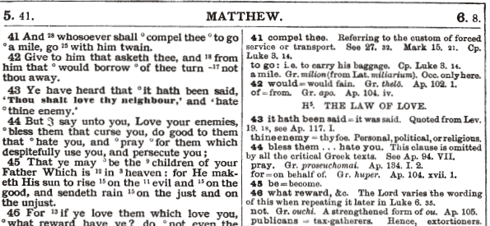
Tools for understanding the Bible
Companion Bible
Let’s look at another bad translations and how it should have been translated.
Matt 5:44 But I say unto you, Love your enemies, bless them that curse you, do good to them that hate you, and pray for them which despitefully use you, and persecute you;
Notes:
Let’s look at another bad translation and how it should have been translated.
Matt 5:44 But I say unto you, Love your enemies, bless them that curse you, do good to them that hate you, and pray for them which despitefully use you, and persecute you;
That’s how it reads, which makes zero sense. It sounds like God wants us to let people just run over us.
This verse should read like this: Matt 5:44 But I say unto you, Love your enemies, and pray for them that persecute you. That’s it. The rest was added, and if you don’t have a Companion Bible, you wouldn’t know that. You’ll see another one of those little circles before (bless them that curse you) and if you look for vs 44 in the side column, you’ll see the statement (This clause is omitted by all the critical Greek Text).
Another mistranslation, it could be on purpose or just a mistake, but never forget Satan's method of operation is to pervert God’s word. He tried it with Jesus in the wilderness and failed big, but Ya’ll we aren’t Jesus and Satan is a supernatural Arch Angel. He was God’s highest-ranking Angel, “the morning star”. Protector of the mercy seat. He’s not to be underestimated. He’s already condemned to death in Ezekiel 28:17-19; he’s a loose cannon and all he has left is to deceive and drag God’s children to hell with him. These subtle changes in God’s word are more important than you realize, a simple word like “was vs became” can change the meaning without you even noticing the difference, and that’s what he’s looking for.

Slide 11
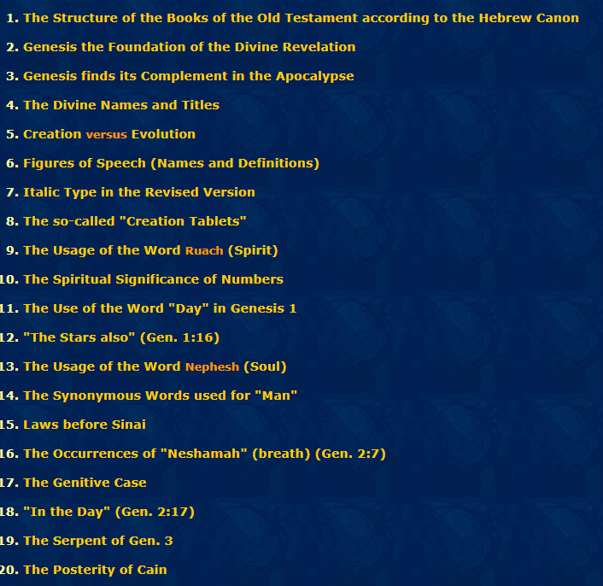
We’ve covered the Companion Bible Marginal notes. Now let’s look at the 198 Appendixes that are in the back of your bible.
Here is appendixes 1-20.
Notes:
We’ve covered the Companion Bible Marginal notes. Now, let’s look at the 198 Appendixes that are in the back of your bible. The Bible and Appendixes are both available to use for free online.
Here’s appendixes 1-20. There is so much great information and it’s right from the word. This man spent his entire life putting together this amazing work. When you learn to use all the tools together, you can judge for yourself how the word is translated and be confident in your knowledge, and you won’t be deceived by the EX Morning-Star.
Our next slide is Appendix 29, the lineage of Abraham it starts with his father Terah/Torah and if you follow Judea’s line it leads to Jesse, King David's father, which is the lineage Christ would be born through. Satan has been trying to disrupt this lineage since the beginning and God has struck him down at every attempt. But remember, he used just everyday people like you and me to defeat Satan and will again in a remarkable way.

Slide 12
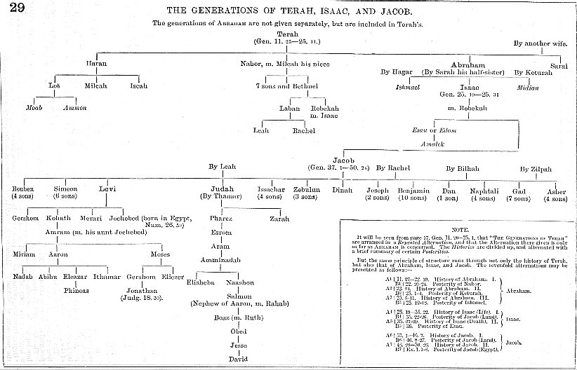



This is Appendix 29 from the Companion Bible
Notes:
Terah, at the top of our chart, is the nineteenth generation in the lineage from Adam and ninth generation from Noah through Noah's son Shem. As you can see the bloodline always stayed intact, this bloodline remained pure from Adam to Jesus and God made sure of it. A couple good examples are: The story of Thamar and Judah and the story of Noah's family.

Slide 13

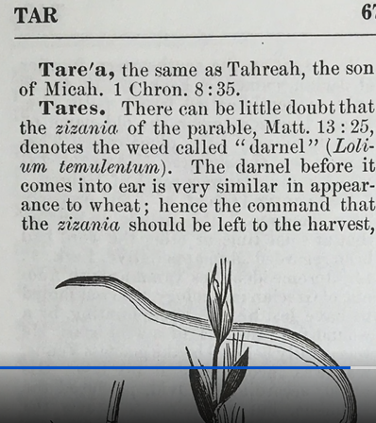
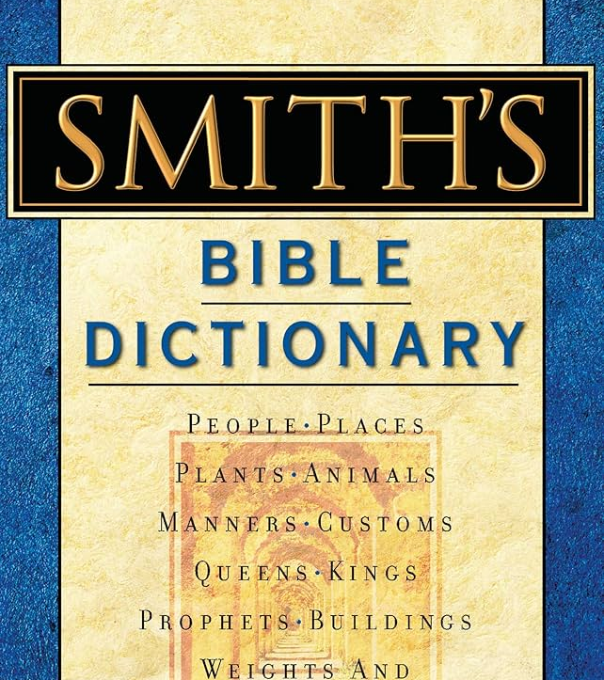
Notes:
PART 2
The Smith’s bible dictionary is great for getting more information for specific words. Let’s look at the word Tares as in the Parable of the Tares. Biblical names are also listed here, most of the Bible names, describe the personality of that individual. Lots of great information.
Matthew 13: 24-30 the Parable of the Tares and 34-52 Jesus explains the Parable of the Tares to the disciples.
https://www.kingjamesbibleonline.org/Matthew-13-38/
Open link and cover all words in verse

Slide 14
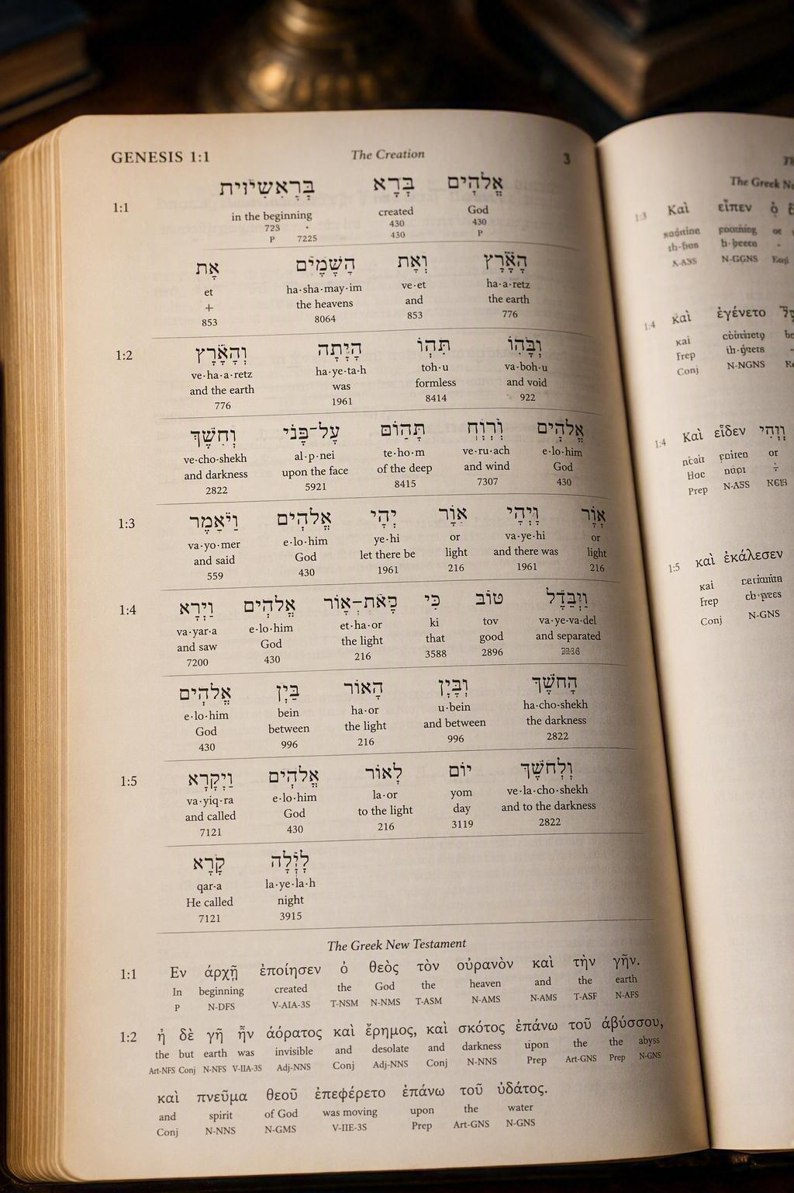
Tools for understanding the Bible
Green's Interlinear Bible
Notes:
The Green’s Interlinear Bible is a word for word translation from Greek to English; there are a couple other versions out there, but what makes this one the best is “the suggested translations and notes”, from so called Scholars have been removed and it remains up to God, who he chooses to enlighten with the truth of his word and not “the enlightened opinion of some man".
Some, controversial topics of the bible today, are so far off base that some people won’t believe the truth even after being shown multiple examples. They are just to subborn to accept the truth and admit to themselves, what they were taught could be wrong. I’ve been told by a preacher after a discussion about wine vs grape juice, that he “chooses to believe” when the bible speaks of wine that is not of the alcoholic type, when it’s perfectly clear that wine is wine. In the bible and in history, it was simply a way of life, in that time. They had no refrigeration and fermentation was the only way to preserve their grapes.
Just because your favorite preacher says it, doesn’t mean you shouldn’t check him for accuracy, and that goes for, this man too.

Slide 15
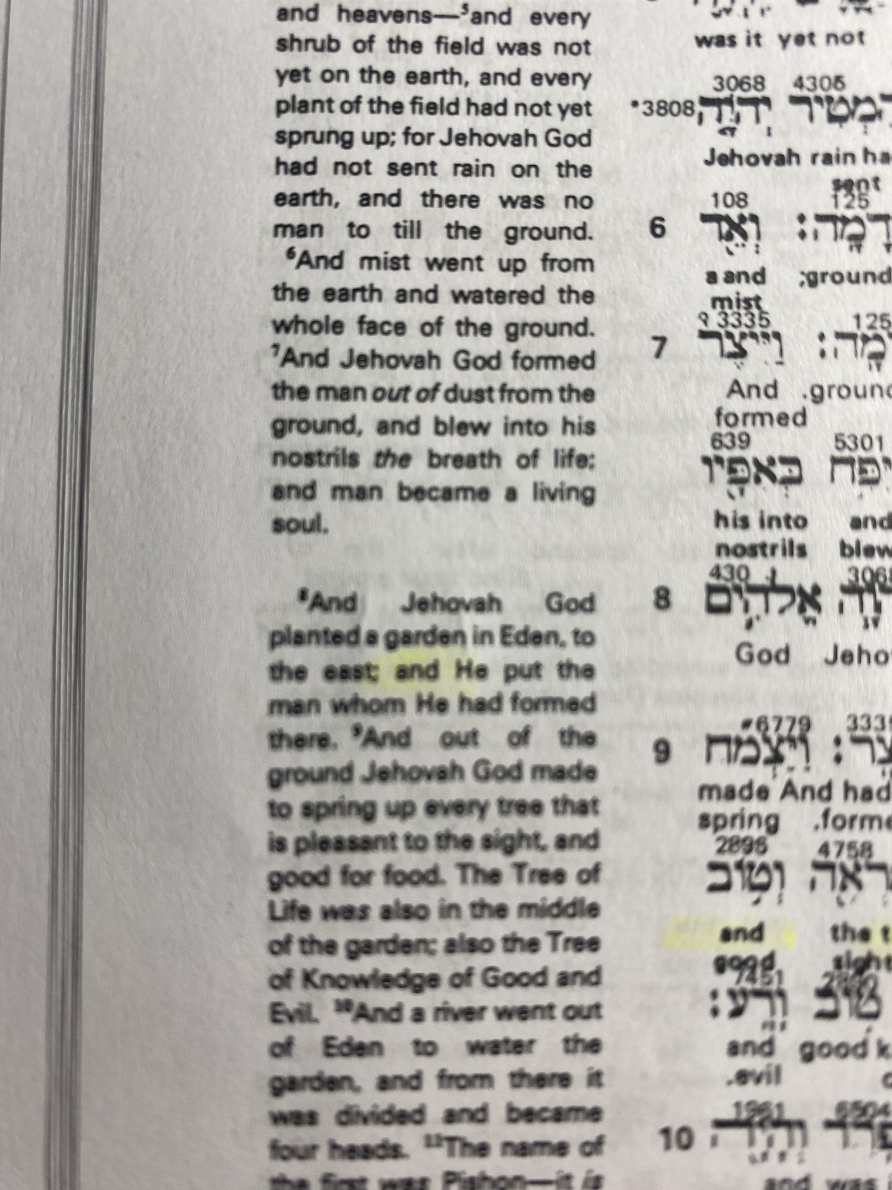
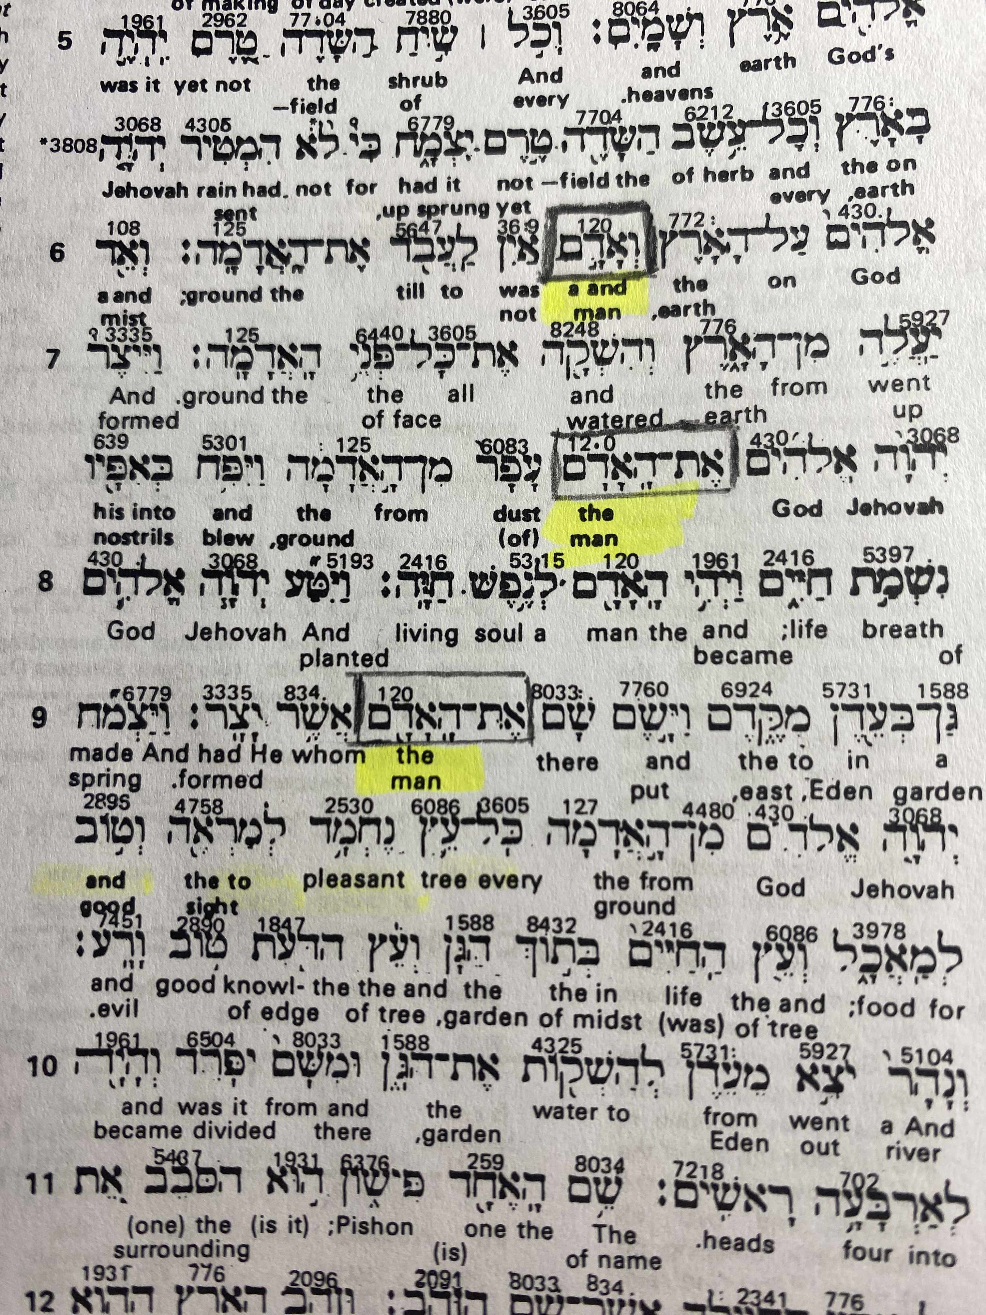


Notes:
In this example, we're looking at the word "man" the different ways it's used in Genesis, and how it's used when speaking of the creation of Adam in Gen 2:7 vs the creation of man in Gen 1:26-27.
Gen 1:26 And God said, Let us make man in our image,after our likeness: and let them have dominion over the fish of the sea, and over the fowl of the air, and over the cattle, and over all the earth, and over every creeping thing that creepeth upon the earth.
Gen 1:27 So God created man in his own image, in the image of God created he him; male and female created he them.
Genesis 2:7 And the LORD God formed man of the dust of the ground, and breathed into his nostrils the breath of life; and man became a living soul
In this example we're looking at the word "man" and the different ways it's used in Genesis and how it's used when speaking of the creation of Adam in Gen 2:7 vs the creation of man in Gen 1:26-27.
Hebrew is read from left to right and we're about to see the challenges the translators faced in going from Hebrew to English. You'll notice as we go through this verse the Hebrew words aren't enough for understanding, The words in Hebrew are much more meaningful and the translators had to fill in the verses with additional English words to make complete sentences. The difference between the two uses of man in Genesis is as simple as punctuation or what is called an article in the Hebrew language in chapter two the word man has this article and changes the word from "Adam" to "The Adam". Adam was supposed to do what Christ did, but that incident in the Garden with Eve and Satan put an end to plan A, and gave Satan dominion of the entire Earth. So you see, this was a special creation. The man in Gen 1:27 is man or mankind as a whole, which includes all of the gentile races. It did not include "The Adamic race" Now let's look at the Strongs definition.
Strongs H120: another, hypocrite, common sort, low, man mean, of low degree, person
From 'adam; ruddy i.e. A human being (an individual or the species, mankind, etc.) -- X another, + hypocrite, + common sort, X low, man (mean, of low degree), person.
You can see above how the translators interpreted both words. So, it appears there was another creation or in this case it's called formed. If we look at the Archaeology and history of the world from this time period, there is much historical evidence that the races (other than white peoples) history goes back a couple thousand years beyond when Adamic race appears in the picture. A couple examples are the Oriental's: China, Japan, Mayna, Egypt, Ethiopia etc.... Incredible archeological evidence all over the world. But nothing that indicates the white race in those time periods and if Adam wasn't created until chapter two then the bible lines up with history.
Gen 1:26And God said, Let us make man in our image (or in our resemblance), after our likeness: and let them have dominion (reign or to rule over) over the fish of the sea, and over the fowl of the air, and over the cattle, and over all the earth, and over every creeping thing that creepeth (or moves, not just the creepy crawly things) upon the earth.
27So God created man in his own (in italics means added) image, in the image of God created he him; male and female created he them.
28And God blessed them, and God said unto them, Be fruitful, and multiply, and replenish (mean to fill) (notice he said replenish that means to do it again, was it plenished or filled, before this creation) the earth, and subdue it: and have dominion over the fish of the sea, and over the fowl of the air, and over every living thing that moveth upon the earth.
29And God said, Behold, I have given you every herb bearing seed, which is upon the face of all the earth, and every tree, in the which is the fruit of a tree yielding seed; to you it shall be for meat. (meat mean food or consume)
30And to every beast of the earth, and to every fowl of the air, and to every thing that creepeth upon the earth, wherein there is life, I have given every green herb for meat: and it was so.
31And God saw every thing that he had made, and, behold, it was very good. And the evening and the morning were the sixth day.
2:1Thus the heavens and the earth were finished, and all the host of them.
2And on the seventh day God ended his work which he had made; and he rested on the seventh day from all his work which he had made.
3And God blessed the seventh day, and sanctified it: because that in it he had rested from all his work which God created and made.
4These are the generations of the heavens and of the earth when they were created, in the day that the LORD God made the earth and the heavens,
5And every plant of the field before it was in the earth, and every herb of the field before it grew: for the LORD God had not caused it to rain upon the earth, and there was not a man to till the ground.
6But there went up a mist from the earth, and watered the whole face of the ground.
7And the LORD God formed man of the dust of the ground, and breathed into his nostrils the breath of life; and man became a living soul.
8And the LORD God planted a garden eastward in Eden; and there he put the man whom he had formed.
9And out of the ground made the LORD God to grow every tree that is pleasant to the sight, and good for food; the tree of life also in the midst of the garden, and the tree of knowledge of good and evil.
10And a river went out of Eden to water the garden; and from thence it was parted, and became into four heads.
11The name of the first is Pison: that is it which compasseth the whole land of Havilah, where there is gold;
12And the gold of that land is good: there is bdellium and the onyx stone.
13And the name of the second river is Gihon: the same is it that compasseth the whole land of Ethiopia.
14And the name of the third river is Hiddekel: that is it which goeth toward the east of Assyria. And the fourth river is Euphrates.
15And the LORD God took the man, and put him into the garden of Eden to dress it and to keep it.
16And the LORD God commanded the man, saying, Of every tree of the garden thou mayest freely eat:
17But of the tree of the knowledge of good and evil, thou shalt not eat of it: for in the day that thou eatest thereof thou shalt surely die.
18And the LORD God said, It is not good that the man should be alone; I will make him an help meet for him.
19And out of the ground the LORD God formed every beast of the field, and every fowl of the air; and brought them unto Adam to see what he would call them: and whatsoever Adam called every living creature, that was the name thereof.
20And Adam gave names to all cattle, and to the fowl of the air, and to every beast of the field; but for Adam there was not found an help meet for him.
21And the LORD God caused a deep sleep to fall upon Adam, and he slept: and he took one of his ribs, and closed up the flesh instead thereof;
22And the rib, which the LORD God had taken from man, made he a woman, and brought her unto the man.
23And Adam said, This is now bone of my bones, and flesh of my flesh: she shall be called Woman, because she was taken out of Man.
24Therefore shall a man leave his father and his mother, and shall cleave unto his wife: and they shall be one flesh.
25And they were both naked, the man and his wife, and were not ashamed.
Do you believe God? Or do you just believe in God?
This is God’s Word verified by the inspired manuscripts, that God himself gave to his prophets. You must believe God's word, no matter the traditions you’ve been taught in the past. There is no room for error in these End Times and it’s time to get Gods Word straight. We can’t make Christ's enemies his footstool, without the unedited word of God and the entire gospel armor.

Slide 16
Hebrew Word Study: Two Different Creations
Comparing the Hebrew verbs behind “Let Us make man” (Genesis 1:26) and “the LORD God formed man” (Genesis 2:7)
Genesis 1:26 — נַעֲשֶׂה (Na’aseh) “Let Us make”
Letter | Name | Sound
נ | Nun | N
ע | Ayin | (silent guttural)
שׂ | Sin | S
ה | Heh | (soft H)
Root: עשה (ASAH) = to make, do, construct — a broad, general term
Genesis 2:7 — וַיִּיצֶר (Vayyitzer) “And He formed”
Letter | Name | Sound
ו | Vav | V (“and”)
י | Yod | Y (prefix)
י | Yod | Y (root)
צ | Tsade | TS
ר | Resh | R
Root: יצר (YATZAR) = to form/fashion like a potter molds clay
Key distinction: Genesis 1:26 uses ASAH — a broad, general word for “make” — to describe mankind (אָדָם Adam, no definite article) as a class — male and female, a population. Genesis 2:7 uses YATZAR — a specific, hands-on “forming,” like a potter shaping clay — to describe THE man (הָאָדָם Ha-Adam, WITH the definite article “ha-”) — one specific, particular individual, formed from the dust and given the breath of life directly by God.
Notes:
What this slide is showing:
This slide continues the tool we just introduced (Green’s Interlinear Bible) by taking one more step — actually breaking down the Hebrew letter by letter, for people who don’t read Hebrew. We are comparing the specific VERB used in each verse, because the verb is where the real difference in meaning shows up.
Left table — Genesis 1:26 (“Let Us make man”):
The word is Na’aseh, from the root ASAH (Ayin-Sin-Heh). ASAH is a broad, general Hebrew verb — it just means “to make, do, construct, accomplish.” It’s the same kind of word you’d use for making a garment, doing a task, or building something. It does not describe a hands-on, individual, one-at-a-time act. In Genesis 1:26-27 this word describes God making mankind broadly — “male and female created he them” — a population, not one single person.
Right table — Genesis 2:7 (“the LORD God formed man”):
The word is Vayyitzer, from the root YATZAR (Yod-Tsade-Resh). YATZAR is a completely different word from ASAH — it means “to form, shape, fashion,” the way a potter forms a vessel out of clay with his hands. It’s the exact word used in Jeremiah 18:2-6 and Isaiah 64:8 for a potter shaping clay. This is a specific, intimate, hands-on act — not a broad, general one. And notice the noun changes too: Genesis 1:26 just says “adam” (mankind, no article), but Genesis 2:7 says “ha-adam” — WITH the definite article “ha” (“the”) — meaning THIS particular, specific man, formed individually and given the breath of life directly, breathed into his nostrils.
Why this matters for the study:
Genesis 1 and Genesis 2 use two different verbs on purpose. Genesis 1:26 (ASAH) describes the general creation of mankind — the Gentiles, made broadly, male and female, told to be fruitful and multiply and replenish the earth. Genesis 2:7 (YATZAR) describes a separate, later, specific, hands-on forming of one particular man — Adam — placed in the Garden of Eden and given a soul directly by God’s breath. This is the Hebrew evidence behind the Pre-Adamite reading we’ve been building: the Gentile nations trace back to the earlier, broader Genesis 1 creation, while Adam is a distinct, later, chosen line.
Teaching note: this letter breakdown is simplified for an English-speaking audience (it shows the consonants as they appear in the interlinear, not a full grammatical parse of prefixes/vowel pointing). The key teaching point is the ROOT WORD difference — ASAH vs. YATZAR — and the ADAM vs. HA-ADAM distinction, both of which are accurate and verifiable in Strong’s Concordance (H6213 asah; H3335 yatzar) and any interlinear Bible, including the Green’s Interlinear referenced on the previous slide.

Slide 17
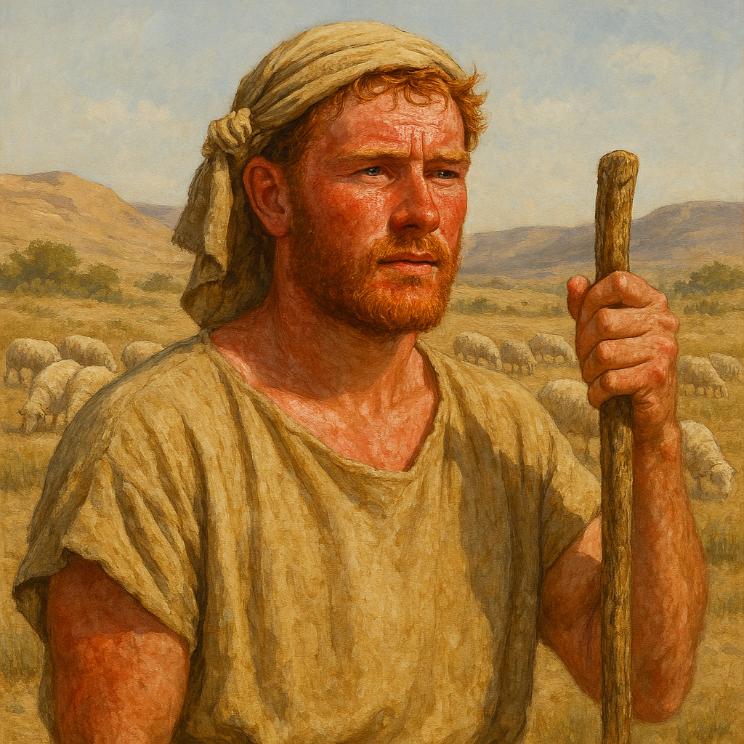
One last thing before finishing up with Adam. We need to understand this word "ruddy" it's only used 4 times in the bible.
Strong's Concordance definition
red, ruddy
Or (fully) admowniy {ad-mo-nee'}; from 'adam; reddish (of the hair or the complexion) -- red, ruddy.
see HEBREW 'adam
So the decendents of Adam are ruddy complected, red-headed, fair-skined. All verses below have the same meaning as above.
Song of Solomon 5:10 My beloved is white and ruddy, the chiefest among ten thousand. This is a Maiden of Isreal's dream
1 Samuel 17:42 And when the Philistine looked about, and saw David, he disdained him: for he was but a youth, and ruddy, and of a fair countenance. Fair countenance used here is beautiful appearance. I would say, a little redheaded pretty boy, with a hand full of rocks. What do you think you're going to do?
1 Samuel 16:12 And he sent, and brought him in. Now he was ruddy, and withal of a beautiful countenance, and goodly to look to. And the LORD said, Arise, anoint him: for this is he. In this verse Samuel is looking for the next King (which is David) and God tells him, it's one of the sons of Jesse, so Samuel heads to Jesse's house and Jesse brings all his sons before Samuel and God said, nope not one of these. So, Jesse says I've got one more but, he's the youngest and just a shepherd in the field taking care of sheep. And just like God, he picks the last one anybody would imagine, the runt of the litter. The next King of God's people. The pretty little redhead with the handful of rocks.
Lamentations 4:7 Her Nazarites were purer than snow, they were whiter than milk, they were more ruddy in body than rubies, their polishing was of sapphire: This is saying they are whiter than milk, yet red like rubies. Fair skinned people living and working outside in a desert environment. Their skin would definingly be reddish and redness of the face.
This concludes our tools for understanding the Bible, now we're going to put what we learned to work,
We’re looking at did Jesus' drink wine? Then “The Fallen Angels”. One very simple, the other not so much, but we use the same process to prove both. By doing what Jesus told us and that is compare scripture with scripture. Now, let’s look at four passage on wine and see if they all, teach us the same thing. John 2:1-11, Matthew 26:27-29, Psalms104:15 and Luke 7:34. That’s 3 gospels and the Old Testament, if three gospels teach the same thing & the Old Testament. Then we have an undisputable case, and it doesn’t matter what anyone says.​
Notes:
One last thing before finishing up with Adam. We need to understand this word "ruddy" it's only used 4 times in the bible.
Strong's Concordance definition
red, ruddy
Or (fully) admowniy {ad-mo-nee'}; from 'adam; reddish (of the hair or the complexion) -- red, ruddy.
see HEBREW 'adam
So the decendents of Adam are ruddy complected, red-headed, fair-skinned. All verses below have the same meaning as above.
Song of Solomon 5:10 My beloved is white and ruddy, the chiefest among ten thousand. This is a Maiden of Isreal's dream
1 Samuel 17:42 And when the Philistine looked about, and saw David, he disdained him: for he was but a youth, and ruddy, and of a fair countenance.
1 Samuel 16:12 And he sent, and brought him in. Now he was ruddy, and withal of a beautiful countenance, and goodly to look to. And the LORD said, Arise, anoint him: for this is he. In this verse Samuel is looking for the next King (which is David) and God tells him it's one of the sons of Jesse, so Samuel heads to Jesse's house and Jesse brings all his sons before Samuel and God said nope, not one of these. So, Jesse says I've got one more but he's the youngest and just a shepherd in the field taking care of sheep. And just like God, he picks the last one anybody would imagine, the runt of the litter. The next King of God's people.
Lamentations 4:7 Her Nazarites were purer than snow, they were whiter than milk, they were more ruddy in body than rubies, their polishing was of sapphire: This is saying they are whiter than milk, yet red like rubies. Fair skinned people living and working outside in a desert environment. Their skin would definitely be reddish and redness of the face.
This concludes our tools for understanding the Bible, now we're going to put what we learned to work.

Slide 18
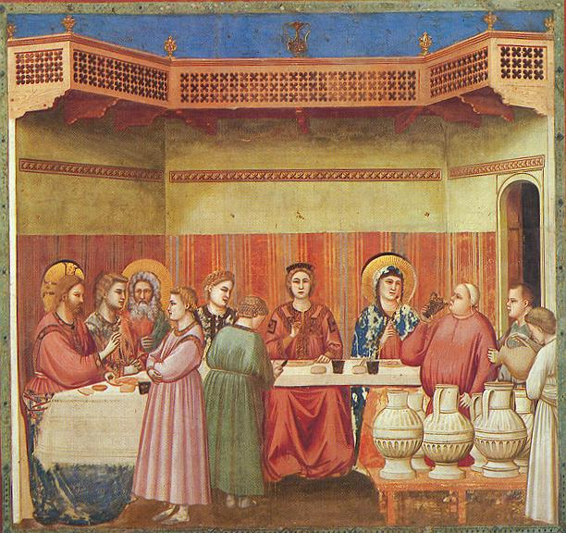
Biblical Marriage Celebrations and the Miracle of Wine
John 2:1 And the third day there was a marriage in Cana of Galilee; and the mother of Jesus was there:
John 2:2 And both Jesus was called, and his disciples, to the marriage.
John 2:3And when they wanted wine, the mother of Jesus saith unto him, They have no wine. John 2:4Jesus saith unto her, Woman, what have I to do with thee? mine hour is not yet come.
John 2:5His mother saith unto the servants, Whatsoever he saith unto you, do it. John 2:6And there were set there six waterpots of stone, after the manner of the purifying of the Jews, containing two or three firkins apiece.
John 2:7Jesus saith unto them, Fill the waterpots with water. And they filled them up to the brim.
Notes:
First, we’re looking at did Jesus' drink wine? By doing what Jesus told us, comparing scripture with scripture. Now, let’s look at four passages on wine and see if they all teach us the same thing. John 2:1-11, Matthew 26:27-29, Psalms104:15 and Luke 7:34. That’s 3 gospels and the Old Testament, if three gospels teach the same thing & the Old Testament, then we have an undisputable case, and it doesn’t matter what anyone says this is the truth, like it or not.
John 2:1 And the third day there was a marriage in Cana of Galilee; and the mother of Jesus was there:
John 2:2 And both Jesus was called, and his disciples, to the marriage. Jesus and his disciples were invited to the wedding celebration; the wedding celebration was a big party with lots of eating and drinking. Normally there was no ceremony with vows and a preacher. The marriage supper was announced and everybody showed up for the party and afterwards, the husband and the wife consummated the arrangement, and it was a done deal. In many cases the husband and wife barely knew each other. And I’m sure a few cups of wine helped settle the nerves in those cases.
John 2:3And when they wanted wine, the mother of Jesus saith unto him, They have no wine. So, first we ask who is they in this verse? It’s Jesus and his disciples. Cups in hand looking for some wine. Mother Mary seems to be helping out at the wedding, when they run out of wine. So, she tells Jesus, to turn this water into wine, but she just says; we have no wine, and I’m guessing a look came with that statement.
John 2:4Jesus saith unto her, Woman, what have I to do with thee? mine hour is not yet come. Jesus says, Really Mother. You want me to do this right here in front of all these people and you know it’s not time for me to do this stuff. And the son of God! did what his Mama told him, even if he didn’t like it.
John 2:5His mother saith unto the servants, Whatsoever he saith unto you, do it. So, Mary says, I know this isn’t making sense, but just do what he says.
John 2:6And there were set there six waterpots of stone, after the manner of the purifying of the Jews, containing two or three firkins apiece. The Strongs Concordance just calls it a measurement. Google says, there is about 10 gallons in a firkins. So, we have six pots and 2-3 firkins each that’s 12-18 firkins x 10 gallons= 120-180 gallons of wine.
John 2:7Jesus saith unto them, Fill the waterpots with water. And they filled them up to the brim.

Slide 19
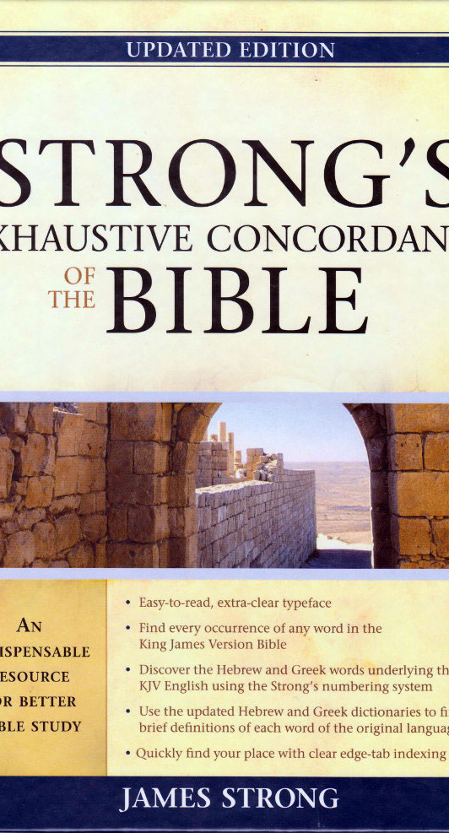

John 2:8 And he saith unto them, Draw out now, and bear unto the governor of the feast. And they bare it.
John 2:9 When the ruler of the feast had tasted the water that was made wine, and knew not whence it was: (the ruler of the feast had no idea where the wine came from.) the governor of the feast called the bridegroom,
John 2:10 And saith unto him, Every man at the beginning doth set forth good wine; and when men have well drunk, then that which is worse: but thou hast kept the good wine until now.
John 2:11 This beginning of miracles did Jesus in Cana of Galilee, and manifested forth his glory; and his disciples believed on him. The first real proof his disciples saw, can you image?
Strong's Concordance definition for wine G3631 G=Greek language. Most of the New Testament.
wine. A primary word (or perhaps of Hebrew origin (yayin)); "wine" (literally or figuratively) -- wine.
see HEBREW yayin Pronounce (yah'-yin) this is the root word for wine and it means:
Strong's Concordance definition for Yayin which is the root word for wine. H3196 H=Hebrew language. Old Testament
banqueting, wine, winebibber (winebibber is a drunkard)
From an unused root meaning to effervesce; wine (as fermented); by implication, intoxication -- banqueting, wine, wine(-bibber).
https://www.kingjamesbibleonline.org/
Notes:
John 2:8 And he saith unto them, Draw out now, and bear unto the governor of the feast. And they bare it.
John 2:9 When the ruler of the feast had tasted the water that was made wine, and knew not whence it was: (the ruler of the feast had no idea where the wine came from.) the governor of the feast called the bridegroom,
John 2:10 And saith unto him, Every man at the beginning doth set forth good wine; and when men have well drunk, then that which is worse: but thou hast kept the good wine until now.
John 2:11 This beginning of miracles did Jesus in Cana of Galilee, and manifested forth his glory; and his disciples believed on him. The first real proof his disciples saw, can you image? This was a quite simple miracle compared to what they will see and do in the very near furture.
Now, we are going to look up some words in the Strong’s concordance, which is made for use with The Authorized King James Bible. Every word in the King James is converted to its original language, assigned a number and with this, you can see every time that word is used and how it was translated. With these tools, you can tell for yourself if it’s translated correctly. We’re still comparing scripture to scripture but now we have the original words, used in the original writings. A sample below.
Strong's Concordance definition for wine G3631 G=Greek language. Most of the New Testament.
wine. A primary word (or perhaps of Hebrew origin (yayin)); "wine" (literally or figuratively) -- wine.
see HEBREW yayin Pronounce (yah'-yin) this is the root word for wine and it means:
Strong's Concordance definition for Yayin which is the root word for wine. H3196 H=Hebrew language. Old Testament
banqueting, wine, winebibber (winebibber is a drunkard)
From an unused root meaning to effervesce; wine (as fermented); by implication, intoxication -- banqueting, wine, wine(-bibber).

Slide 20
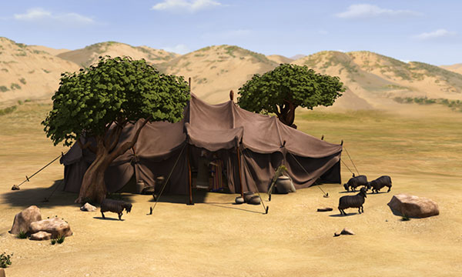
Genesis 29:21 And Jacob said unto Laban, Give me my wife, for my days are fulfilled, that I may go in unto her.
Genesis 29:22 And Laban gathered together all the men of the place, and made a feast.
Genesis 29:23 And it came to pass in the evening, that he took Leah his daughter, and brought her to him; and he went in unto her.
Genesis 29:24 And Laban gave unto his daughter Leah Zilpah his maid for an handmaid.
Genesis 29:25 And it came to pass, that in the morning, behold, it was Leah: and he said to Laban, What is this thou hast done unto me? did not I serve with thee for Rachel? wherefore then hast thou beguiled (deceive) me
Notes:
Here is another good example of consumption of wine and we learn about Jesus' ancestry. In this case Jacob (Who is the grandson of Abraham and son of Isaac) Young Jacob had a few too many and ended up married to the wrong woman. The marriage of Jacob and Rachel should be a story of two young people in love and they were. But it didn’t quite work out that way because Jacob had few too many cups of wine.
(Back story of Jacob and his twin brother Esau). The name Jacob means heal-catcher or supplanter which means someone who wrongfully seizes or holds the place of another. He was named this because at birth he came from the womb holding onto the heel of Esau the first born.
Gensis 25:22And the children struggled together within her; and she said, If it be so, why am I thus? And she went to enquire of the LORD.
23And the LORD said unto her, Two nations are in thy womb, and two manner of people shall be separated from thy bowels; and the one people shall be stronger than the other people; and the elder shall serve the younger.
24And when her days to be delivered were fulfilled, behold, there were twins in her womb.
25And the first came out red, all over like an hairy garment; and they called his name Esau.
26And after that came his brother out, and his hand took hold on Esau's heel; and his name was called Jacob: and Isaac was threescore years old when she bare them.
So, these boys grow up, and Esau is Dad's favorite because he's a cunning hunter a man of the field and the bible say Jacob was plain man, dwelling in tents. So, Jacob was mom's favorite, but she knows something that no one else knows. When the twins were born God told her the elder would serve the younger, which meaning Jacob was to receive the Birthright blessing and not Esau. So, when Isaac was old and his eyes were dim (he was blind as a bat). It's time to give the blessing and return to the father. Notice here that Isaac blessed Jacob, he didn't ask God to do it. God already blessed Isaac and it's Isaac's responsibility to pass that bless on to his son. Just like Abraham did for him, not Gods.(much more on this later) So, Rebekah overhears Isaac tell Esau, go to the field and kill me a deer and make me some venison, that I may eat and bless you before the LORD before my death. So, Esau goes hunting.
And while he’s gone, Rebekah whips up some venison and dresses Jacob up in Esau's clothes, puts the skins of a kid goat on his hands and his neck to make him hairy. Isaac was deceived by this plan and blessed Jacob instead of Esau. Now Esau shows up and he's very angry when he finds out what has happened and says after their dad is dead and gone, Jacob is next.
So, Jacob gets sent to his Uncle Laban (mom's brother), so he'll be safe from Esau and Dad told him, while he's there pick out a wife from his cousins, that are of the bloodline and get married. Which was the law, they were not allowed to marry outside of that bloodline. But, Esau married outside the bloodline (he married a Hittite). Now Jacob is living with Laban for about seven years.
Genesis 29:21 And Jacob said unto Laban, Give me my wife, for my days are fulfilled, that I may go in unto her. Jacob agreed to work for Laban for seven years and in return Jacob gets Rachel for his wife. In this verse the seven years is complete and it’s time for the marriage celebration and then, it’s time to consummate the marriage.
Genesis 29:22 And Laban gathered together all the men of the place, and made a feast.
Genesis 29:23 And it came to pass in the evening, that he took Leah his daughter, and brought her to him; and he went in unto her. We are still talking about Laban. The way this works is Laban takes his daughter to the tent and then Jacob comes into the tent and consummates the marriage. But Laban takes Leah to the tent instead of Rachel.
How in the world would Jacob walk into that tent, then crawl into bed with his new sister in-law and not know the difference? Laban was slick, he had this thing planned out and was probably feeding Jacob wine all day, got him drunk and played him like a fiddle. Now, he’s going to make Jacob wait another seven years for Rachel. I would wager that it was a long seven years sleeping with Rachel's sister and being in love with Rachel. This poor guy is going to get hammered from two directions for the rest of his life.
Genesis 29:24 And Laban gave unto his daughter Leah Zilpah his maid for an handmaid. She gets Labans maid and eventually Jacob gets told to take her for wife too.
Genesis 29:25 And it came to pass, that in the morning, behold, it was Leah: and he said to Laban, What is this thou hast done unto me? did not I serve with thee for Rachel? wherefore then hast thou beguiled (deceive) me? Jacob doesn’t know he was with the wrong woman till morning. If this were you and you were sober, would you know if it was your wife's sister and not your wife. Sober yes, you would. What if you were drinking all day with your family (Laban) and friends? Sound like he had way too much to drink and got taken advantage of. If he were sober, he could have put a stop to it, but he consummated the marriage and got himself a wife that he didn't want.

Slide 21
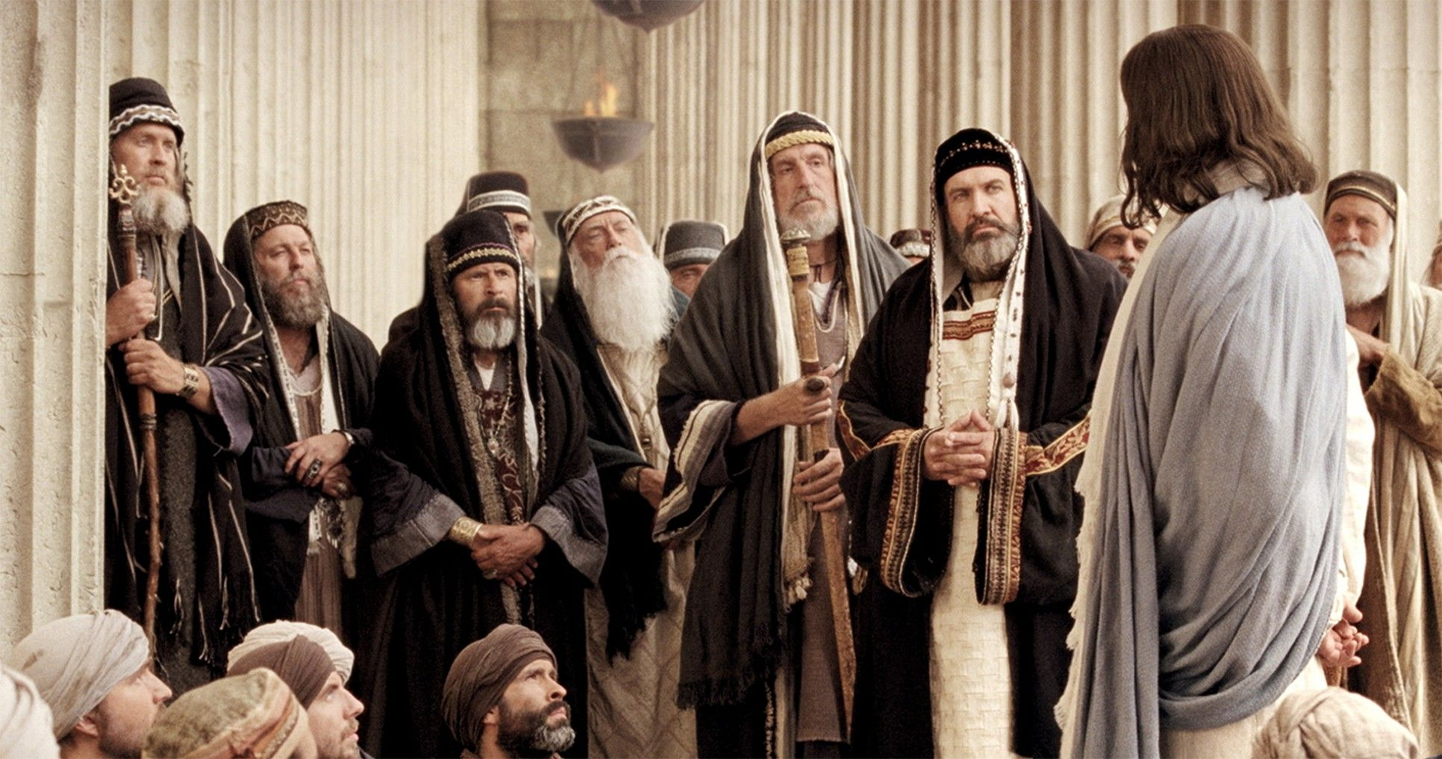
In Luke Chapter 7 Jesus is talking to a crowd of people and some Pharisees.
Luke 7:31 And the Lord said, Whereunto then shall I liken the men of this generation? and to what are they like?
Luke 7: 32 They are like unto children sitting in the marketplace, and calling one to another, and saying, We have piped unto you, and ye have not danced; we have mourned to you, and ye have not wept.played the flute and mourned is to lament or bewail.
Luke 7: 33 For John the Baptist came neither eating bread nor drinking wine; and ye say, He hath a devil. John had the Holy Spirit from the womb, and he was a Nazarite Luke 1:15 says “he shall be great in the sight of the Lord, and shall drink neither wine nor strong drink and shall be filled with the Holy Ghost, even from his mother’s womb”
Luke 7: 34 The Son of man is come eating and drinking; and ye say, Behold a gluttonous man, and a winebibber, a friend of publicans and sinners! .
Notes:
In Luke Chapter 7 Jesus is talking to a crowd of people and some Pharisees.
Luke 7:31 And the Lord said, Whereunto then shall I liken the men of this generation? and to what are they like?
Luke 7: 32 They are like unto children sitting in the marketplace, and calling one to another, and saying, We have piped unto you, and ye have not danced; we have mourned to you, and ye have not wept.
These Pharisees act like spoiled children complaining that no one is dancing to their music and nothing Jesus or John could do would please them. It’ll make more sense when we read the next two verses.
Luke 7: 33 For John the Baptist came neither eating bread nor drinking wine; and ye say, He hath a devil. John had the Holy Spirit from the womb, and he was a Nazarite. Luke 1:15 says “he shall be great in the sight of the Lord, and shall drink neither wine nor strong drink and shall be filled with the Holy Ghost, even from his mother’s womb” These religious leaders Jesus is talking to, say John the Baptist has a devil. You see the limits of their spiritual discernment. This is one of only a couple times that the bible forbids drinking wine.
Luke 7: 34 The Son of man is come eating and drinking; and ye say, Behold a gluttonous man, and a winebibber, a friend of publicans and sinners! . These Pharisees accuse Jesus of being a drunk because he drinks wine. There we go. Jesus drank fermented wine. Almost everyone did. Grape juice would spoil in no time; they didn’t have refrigeration; you had to ferment it, to keep it. And if you didn’t, your drinking water and goats' milk for the next 8 months. Do you believe Gods word? This is also just history, along with some common sense.

Slide 22
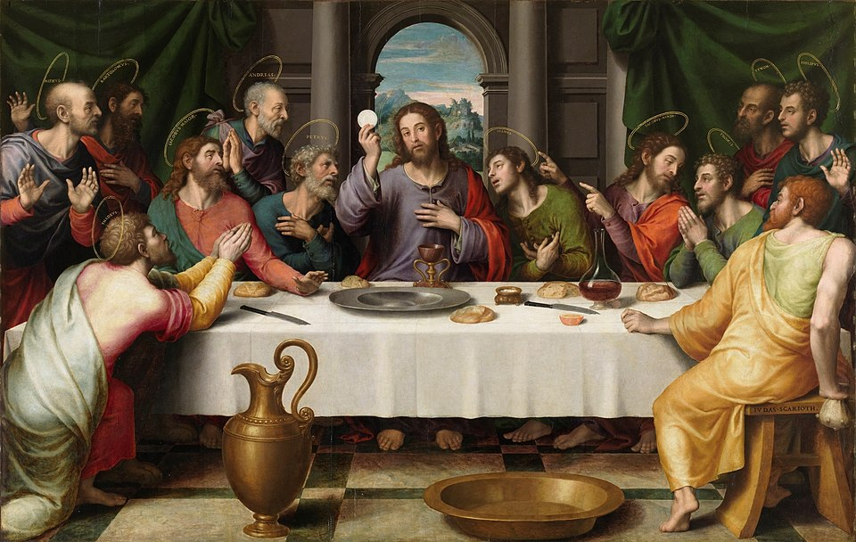
The Last Supper
Matt 26:27 And he took the cup, and gave thanks, and gave it to them, saying, Drink ye all of it; Cup used in this verse is (pot-ay'-ree-on) potērion: a wine cup.
Matt 26:28 For this is my blood of the new testament, which is shed for many for the remission of sins.
Matt 26:29 But I say unto you, I will not drink henceforth of this fruit of the vine, until that day when I drink it new with you in my Father's kingdom.
Psalms 104:15 And wine that maketh glad the heart of man, and oil to make his face to shine, and bread which strengtheneth man's heart.
Notes:
These next two are going to be quick, I think the truth is in front of us and it’s time to move on. This is Jesus at the last supper
Matt 26:27 And he took the cup, and gave thanks, and gave it to them, saying, Drink ye all of it; Cup used in this verse is (pot-ay'-ree-on) potērion: a wine cup.
Matt 26:28 For this is my blood of the new testament, which is shed for many for the remission of sins.
Matt26:29 But I say unto you, I will not drink henceforth of this fruit of the vine, until that day when I drink it new with you in my Father's kingdom. He just told the disciples that he would drink wine with them again. In the Father’s Kingdom.
Psalms 104:15 And wine that maketh glad the heart of man, and oil to make his face to shine, and bread which strengtheneth man's heart.
A couple glasses, not a couple bottles is the preference here. Remember what happened to Jacob. So that was simple, we just compared scripture to scripture, we looked up a couple definitions and no more questions on the subject. Now with what you've learned here and the tools we talked about you're now ready to get to work, studying our father's letter to his children.
This concludes “How to study the Bible” I hope you’ve enjoyed this as much as I have enjoyed bringing it to you. Next is The Resurrection of the Dead, then Lucifer & the foundation of the world, then The Three World Ages and When the Earth Became Void and Without Form. With these five studies behind us. We’ll have the basic understanding and are ready for the meat. God loves his children, who love his word.

Slide 23
The Gentile Nations & the Adamic Line
A Comparative Creation Timeline — How to Study the Bible Series

Slide 24
Purpose
This study compares two distinct tracks of early human history: the specific, genealogical line of Adam recorded in Genesis 2–11, and the broader emergence of ‘Gentile’ nations — the descendants of the mankind God created in Genesis 1:26–28 — as documented in the archaeological and historical record.
The goal is to demonstrate that the general population of mankind (the Gentiles) was already present and organizing into nations and civilizations before, and independent of, the specific Adamic line detailed later in Genesis 2.

Slide 25
The Two Creations
Genesis 1:26–28 (Mankind / the Gentiles) vs. Genesis 2:7 (Adam)
Genesis 1:26–28 — Mankind (the Gentiles)
“And God said, Let us make man in our image, after our likeness... So God created man in his own image... male and female created he them... and God said unto them, Be fruitful, and multiply, and replenish the earth.”
This is a general creation of mankind — a population, not a single genealogical line.
Genesis 2:7 — Adam
“And the LORD God formed man of the dust of the ground, and breathed into his nostrils the breath of life; and man became a living soul.”
This is a distinct, later, and specific act — the forming of Adam individually, placed in the Garden of Eden, and given a soul directly breathed by God. Genesis 5 then traces a specific genealogical line from this Adam forward.

Slide 26
Supporting Textual Clues
• Cain fears being killed by others after his exile (Genesis 4:14) — implying a population beyond his immediate family.
• Cain ‘knew his wife’ and built a city (Genesis 4:17) — requiring an existing population to marry into and to populate a city.
• These details are difficult to explain if Adam, Eve, Cain, and Abel were the only living humans on earth at that time.

Slide 27
Comparative Timeline (1 of 2)
Adamic dates: Ussher biblical chronology. Gentile dates: standard archaeological/historical dating.
Date (approx.) | Adamic Line (Gen. 2–11) | Gentile Nations (Gen. 1 mankind → historical record)
4500–4000 BC | — Adam not yet formed | Earliest Sumerian urban settlement at Uruk, Mesopotamia (modern-day Iraq).
4004 BC | Adam formed (Gen. 2:7) — Ussher chronology | Gentile populations already spreading across river valleys.
3300 BC | Adam’s line: Seth, Enosh, Kenan… (Gen. 5, pre-Flood) | Indus Valley Civilization founded (Harappa) (modern-day Pakistan).
3100 BC | Generations before the Flood on Adam’s line | Egyptian First Dynasty — Narmer unifies Upper & Lower Egypt.
3000 BC | — | Caral-Supe (Norte Chico), Peru — oldest known civilization in the Americas.
2700 BC | — | Minoan civilization (Crete) — early palace culture (Greece).

Slide 28
Comparative Timeline (2 of 2)
Adamic dates: Ussher biblical chronology. Gentile dates: standard archaeological/historical dating.
Date (approx.) | Adamic Line (Gen. 2–11) | Gentile Nations (Gen. 1 mankind → historical record)
2500 BC | — | Kerma / Nubian civilization, upper Nile.
2348 BC | The Flood (Ussher chronology) — Noah’s line survives | Egypt already ~7 dynasties deep; Sumer/Akkad flourishing; Indus cities mature.
2242 BC | Tower of Babel / dispersion of nations (Gen. 10–11) | These nations are already centuries into existence as civilizations.
2070 BC | Post-Babel patriarchal era approaching | Xia Dynasty, China — traditionally China’s first dynasty.
2000 BC | Age of the Patriarchs (Abraham, Isaac, Jacob) | Maya civilization begins (Early Preclassic) (southern Mexico to Nicaragua).

Slide 29
The Key Observation
Under the standard Adamic genealogical chronology, Adam is formed around 4004 BC, the Flood occurs around 2348 BC, and the nations of the earth are only divided and named at Babel around 2242 BC (Genesis 10–11).
Observation: Egypt's First Dynasty (c. 3100 BC), Sumer/Uruk's urban civilization (c. 4000+ BC), and the Indus Valley (c. 3300 BC) are already established civilizations before the Flood — and centuries before Babel's dispersion. Some of these dates even approach or predate Adam's own formation.
Resolution: If every Gentile nation descended strictly from Noah's three sons after Babel (Genesis 10), these civilizations should not have deep roots predating that dispersion by more than a thousand years. The Pre-Adamite reading resolves this: Genesis 1's ‘mankind’ (the Gentiles) was created earlier and more broadly, while Adam (Genesis 2) is a distinct, later, chosen representative formed for a specific spiritual purpose in the Garden of Eden.

Slide 30
Additional Gentile Civilizations for Further Study
• Elam (southwestern Iran) — city-states from c. 3200 BC
• Minoan civilization (Crete) — palaces emerging c. 2700 BC
• Kerma / Nubian civilization (upper Nile) — c. 2500 BC
• Norte Chico / Caral, Peru — c. 3000 BC, oldest confirmed civilization in the Americas
• Jomon culture, Japan — pottery-based settlements as early as c. 14,000 BC (pre-dynastic, but among the oldest known cultural continuities)

Slide 31
Sources & Notes
• Adamic chronology: James Ussher, Annals of the World (1650s) — a widely used but not universally accepted biblical chronology; alternate reckonings (e.g., Rabbinic calendar, Masoretic vs. Septuagint genealogies) exist.
• Gentile nation dates: conventional archaeological/historical dating (Wikipedia, Britannica, university research summaries); these dates are subject to ongoing revision as new evidence emerges.
• This timeline reflects a Pre-Adamite / Gap interpretation of Genesis 1–2 and is presented as a teaching resource for the How to Study the Bible series.

